Slide 1
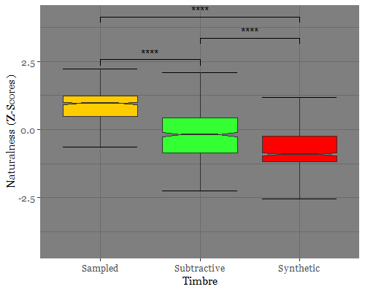
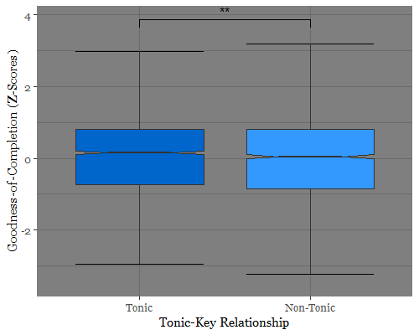
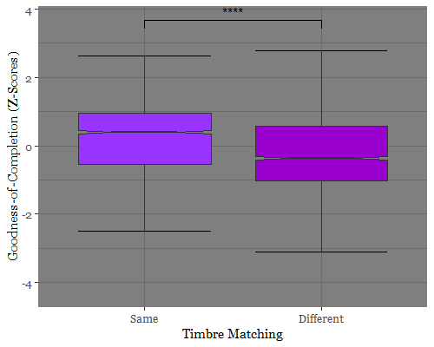
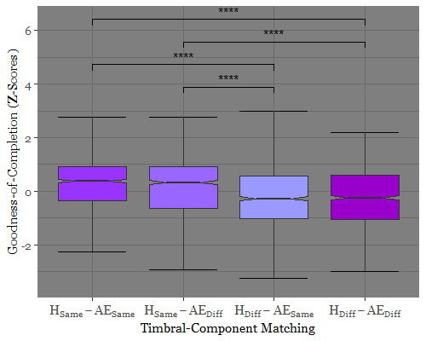
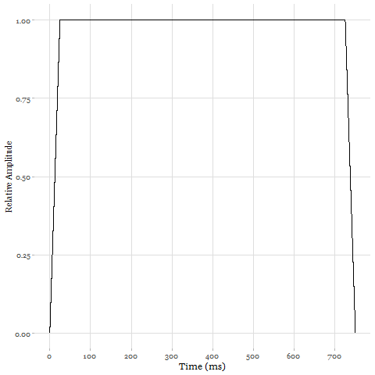
The Nature of Artificial Sounds:
Musical Memory for Key Characterized by Timbre
Graeme Noble¹, Joanna Spyra¹, Matthew Woolhouse²
¹Department of Psychology, Neuroscience and Behaviour, McMaster University
²School of the Arts, McMaster University
^{Contact: nobleg2@mcmaster.ca}
Introduction
Results
Perception of Nonadjacent Keys
Modulation, which occurs throughout Western tonal-harmonic music, results in temporally nonadjacent keys
Musical surface features, such as melody and rhythm, assist with key memorization
Aspects of timbre (e.g., number of harmonics and amplitude envelopes) contribute to the encoding of music, and may thus influence memory of nonadjacent keys
Research Question
Do components of timbre influence memory recognition within a nonadjacent-key paradigm?
Experiment 1: Assessment
Timbre Naturalness:
F_{2, 81} = 96.35, p < .0001, η_{p}² = . 543 (Fig. 3)
Experiment 2: Naturalness
Timbre Matching: F_{1, 63} = 12.08, p < .0001, η_{p}² = .161 (Fig. 4)
Probe Timbre: F ₁,₆₃ = 4.569, p = .036, η_{p}² = .068
Experiment 3: Composition
Tonic-Key Relationship: F_{1, 41} = 9.394, p = .004, η_{p}² = .186 (Fig. 5)
Timbral-Component Matching: F_{3, 41} = 14.60, p < .0001,
η_{p}² = .263 (Fig. 6)
Figure 4: Exp. 2 normalized goodness-of-completion ratings normalized and compared between probe timbres.
Figure 6: Exp. 3 normalized goodness-of-completion ratings compared across timbre matching conditions.
Figure 3: Exp. 1 normalized ratings of naturalness across three timbres.
Figure 5: Exp. 3 normalized goodness-of-completion ratings relative to their tonic-key relationship.
Methods
Experiment 1: Timbre Assessment
Rate 3 timbres for “naturalness”
IVs: Synthetic vs. Subtractive vs. Sampled Timbre
DV: Naturalness
Experiment 2: Timbre Naturalness
Rate closing probe cadence for goodness-of-completion (e.g., Fig. 1)
IVs: Nonadjacent Timbre Matching
DV: Probe Goodness-of-Completion
Experiment 3: Timbre Composition
Influence of timbre components on nonadjacent-key perception
IV1: Tonic vs. Non-Tonic Key Relationship
IV2: Dynamic (AE_{Dyn}) vs. Flat (AE_{Flat}) Amplitude Envelopes
IV3: Single (H₁) vs. Multiple (H₉) Harmonics
IV4: Timbral-Component Matching
(H_{Same}–AE_{Same}; H_{Same}–AE_{Diff};
H_{Diff}–AE_{Same}; H_{Diff}–AE_{Diff})
DV: Probe Goodness-of-Completion
Discussion
References
Experiment 1: Timbre Assessment
Stimuli easily distinguishable based on naturalness
Experiment 2: Timbre Naturalness
Significant effect of timbre matching between nonadjacent key and probe cadence, consistent with hypothesis that memory for timbre persists across keys and distinct timbral transformations
Experiment 3: Timbre Composition
Significant effect of H matching on goodness-of-completion but not AE matching
Significant effect of Tonic-Key Relationship, suggesting memory for key within small timbral transformations
¹Woolhouse, M., Cross, I., & Horton, T. (2015). Perception of nonadjacent tonic-key relationships. Psychology of Music, 44(4), 802–815.
²Spyra, J., Stodolak, M., & Woolhouse, M. (2019). Events versus time in the perception of nonadjacent key relationships. Musicae Scientiae, 102986491986746.
³Deutsch, D. (2013). The psychology of music. London: Academic.
Fig. 1: Example of tonic nonadjacent stimuli used in Exp. 2 and 3:
C major—D major—C major (probe cadence). Keys modulated bidirectionally 1–2 semitones between stimuli sections.
Audio 1: Exp. 1 stimulus of Fig. 1 Probe as Sampled Timbre
Thanks
Nonadjacent Key: C(0) | Intervening Key: D(+2) | Probe Key: C(0)
Audio 2: Exp. 2 stimulus of Fig. 1 Probe as Non-Tonic*, H_{Same}–AE_{Diff}
Fig. 2A, 2B, 2C, 2D, and 2E: Waveforms for all AE and H stimulus combinations presented in Exp. 3:
H₁–AE_{Flat} (2A); H₉–AE_{Flat} (2B); H₅–AE_{Int} (2C);
H₉–AE_{Dyn} (2D); H₁–AE_{Dyn} (2E).
Special thanks to Claire Baguio, Lauren Iafrate, and Madeline Komar for their contributions to the project.
Audio 3: Exp. 3 stimulus of Fig. 1 as Tonic, H_{Same}–AE_{Diff}

